Slide 1



GitHUB PAGes Self Study Session Hosting on github pages

Slide 2
Unlocking Git A Beginner's Guide to Version Control
Teaching Demo by Regel Cabrales

Slide 3

Learning objectives
Understand Version Control
Install and Setup Git
Explore Git Concepts
Creating Repositories
Stage and Commit Changes
Create, Manage, and Merge Branches

Slide 4
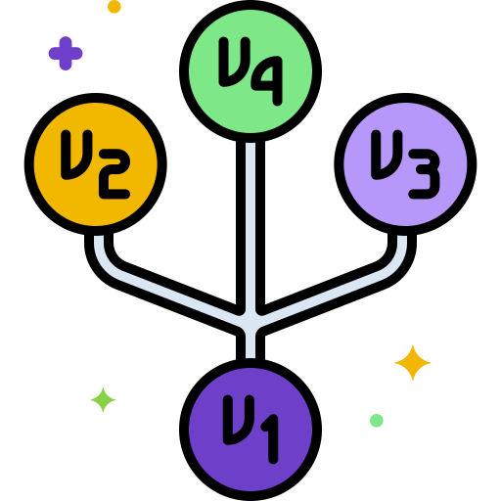

What is Version Control?
Version 1:

Slide 5

What is Version Control?
Version 1:
Version 2:

Slide 6

What is Version Control?
Version 1:
Version 2:

Slide 7
What is Version Control?
Keeping track of changes
Collaborating with other developers
Undoing mistakes
Seeing our progress
Experimenting Safely

Slide 8

Git
A version control system that records changes to our files at any given time
Collaborate on projects and have local versions of the project on your computer
Store revisions of a project in just one directory
Go back to a different version of the project
Work on new features without messing up the main codebase

Slide 9
Installing Git
Download Git - https://git-scm.com/downloads
Download cmder - https://cmder.app
Download VS Code - https://code.visualstudio.com

Slide 10

Repositories (Repo’s)
Container for a project you want to track with Git
Local or Remote
There can be multiple repo’s for different projects on your computer

Slide 11

Repositories (Repo’s)
My Project
-- .git
-- index.html
-- style.css
--
assets
-- logo.png
-- banner.png

Slide 12
Repositories (Repo’s)
My Project
-- index.html
-- style.css
--
assets
-- .git
-- logo.png
-- banner.png

Slide 13
Commits
These are snapshots of the different stages of your project.
You can go back to these snapshots anytime you need to.
Reduce the risk of losing progress on your project

Slide 14



Commits
First commit
Second commit
Third commit
Start

Slide 15
Commits
First commit
Second commit
Third commit
Start
Finished header
Added styles.css
Finished footer

Slide 16
Branches
Master Branch
Starting branch
Stable version of your code
Branch that is published
Master

Slide 17
Branches
Master Branch
Starting branch
Stable version of your code
Branch that is published
Additional Branches
Copy state of code in master branch into a new branch
Isolated environment where we can try out features and changes
If deleted or modified, these will not affect the master branch
Branch 2
Branch 1
Master

Slide 18
REcap
Version Control
Git
Git Concepts
Repositories
Commits
Branches

Slide 19
Thank you

